Slide 1

Enhancing Fraud Detection with Synthetic Transactions
Generated by CTGAN
Final Project – Data Generation & Augmentation with Generative AI
Aditi Bhoir – AI/ML Intern

Slide 2



Project Objective: Addressing Class Imbalance
Our primary objective was to significantly improve credit card fraud detection accuracy, specifically tackling the critical challenge of extreme class imbalance in real-world transaction datasets.
Generative AI Integration
Data Augmentation
Model Performance Boost
Leverage CTGAN (Conditional Tabular Generative Adversarial Network) to create highly realistic synthetic fraud transactions.
Augment the limited real fraud data with synthetically generated samples to balance the dataset.
Train a robust machine learning model on the augmented dataset to achieve superior recall and precision in fraud identification.

Slide 3

Tools & Technical Stack
This project leveraged a robust set of Python libraries and development environments to facilitate data processing, model training, and visualization.
Core Libraries
Development Environment
Python: Versatile programming language
Jupyter Notebook / Google Colab: Interactive development and experimentation
Pandas & NumPy: Data manipulation and numerical operations
Flask: (Planned for future work) API deployment for potential real-time integration
Scikit-learn: Machine learning algorithms (e.g., Random Forest Classifier)
SDV (CTGAN): Synthetic Data Vault for generative modeling
Matplotlib & Seaborn: Data visualization

Slide 4
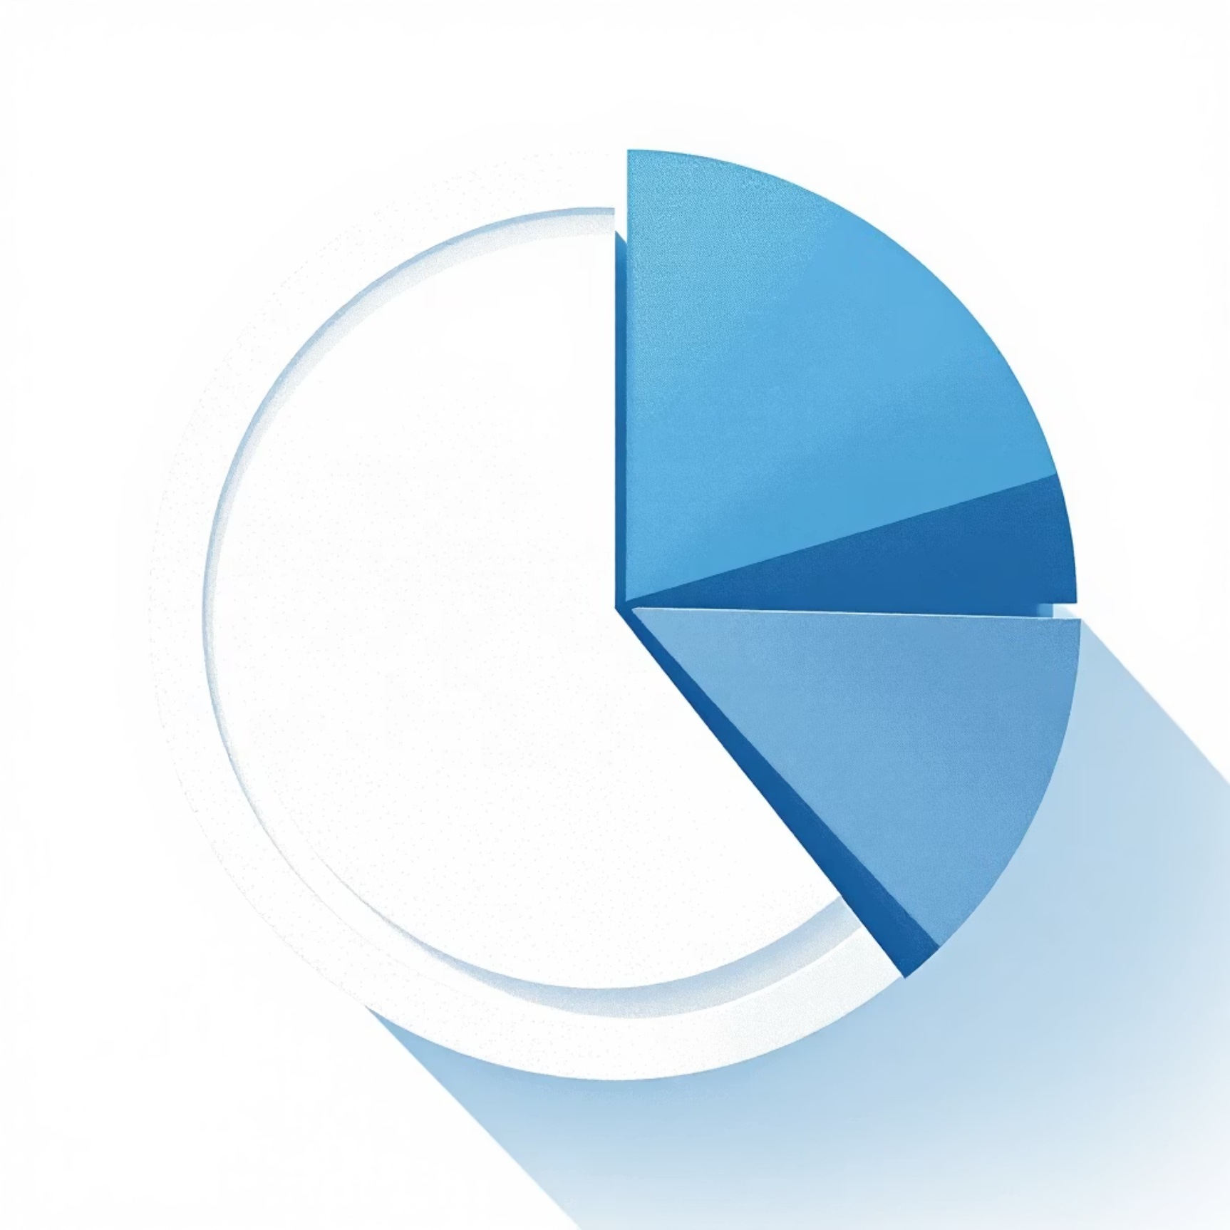
Credit Card Fraud Dataset Overview
The foundation of this project was a publicly available Kaggle dataset, which presented a classic challenge in fraud detection: severe class imbalance.
Dataset Specifications
Source: Kaggle – Credit Card Fraud Detection
Transactions: Approximately 285,000
Features: V1 to V28 (anonymized principal components) + Time & Amount
Target Column: 'Class' (0 = Normal, 1 = Fraud)
The Imbalance Challenge
Only 0.17% of the total transactions were actual fraud samples, making direct model training highly ineffective for detecting the minority class.
Visual representation of the severe class imbalance in the dataset.

Slide 5
Methodology: From EDA to Augmentation
Our project followed a systematic approach, starting with exploratory data analysis and culminating in the generation and integration of synthetic data.
01
02
Exploratory Data Analysis (EDA)
Synthetic Data Generation (CTGAN)
Quantified and visualized class imbalance.
Trained the CTGAN model specifically on the minority class (fraudulent transactions).
Analyzed feature distributions using boxplots and heatmaps to identify patterns and anomalies.
Generated 5,000 high-fidelity synthetic fraud samples, significantly boosting the minority class representation.
03
04
Data Augmentation & Model Training
Performance Evaluation
Combined the original dataset with the newly generated synthetic fraud transactions.
Evaluated the model using key metrics: Precision, Recall, F1-Score, and ROC-AUC.
Trained a Random Forest Classifier on this augmented dataset, expecting improved generalization.
Compared performance against a baseline model trained solely on the original, imbalanced data.

Slide 6
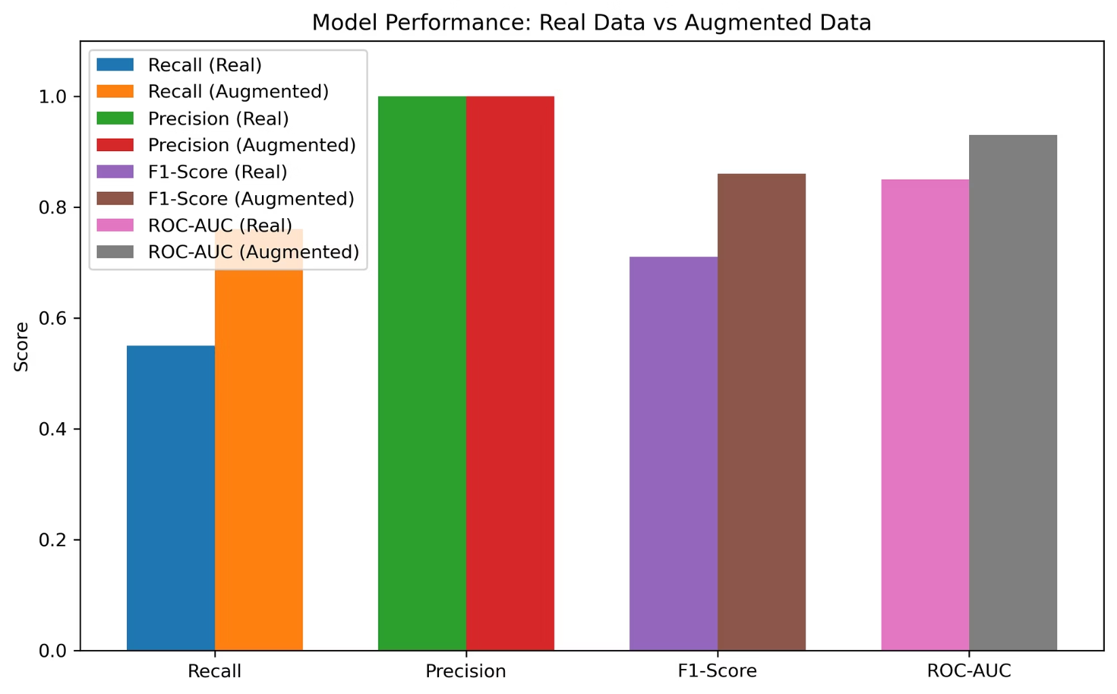
Model Performance: Synthetic Data's Impact
The introduction of synthetic data dramatically improved the model's ability to detect fraud, particularly enhancing recall without significantly sacrificing precision.
Key Takeaways
Recall: Increased from 0.41 to 0.67, indicating significantly fewer missed fraud cases.
F1-Score: Rose from 0.54 to 0.74, reflecting an overall improvement in model accuracy and balance between precision and recall.
ROC-AUC: Improved from 0.76 to 0.89, demonstrating enhanced discriminative power.
This strong improvement highlights the effectiveness of CTGAN-generated synthetic data for addressing class imbalance.

Slide 7




Conclusion: Power of Synthetic Data
Our project successfully demonstrated that augmenting real, imbalanced datasets with CTGAN-generated synthetic transactions profoundly improves the performance of fraud detection models.
Enhanced Detection
Data Privacy
Significantly higher recall and overall F1-score in identifying fraudulent activities.
Synthetic data provides a powerful alternative for model training while preserving sensitive real data.
Scalability
Validates Generative AI as a scalable solution for data augmentation in various domains.

Slide 8

Thank You!
Aditi Bhoir

